Slide 1
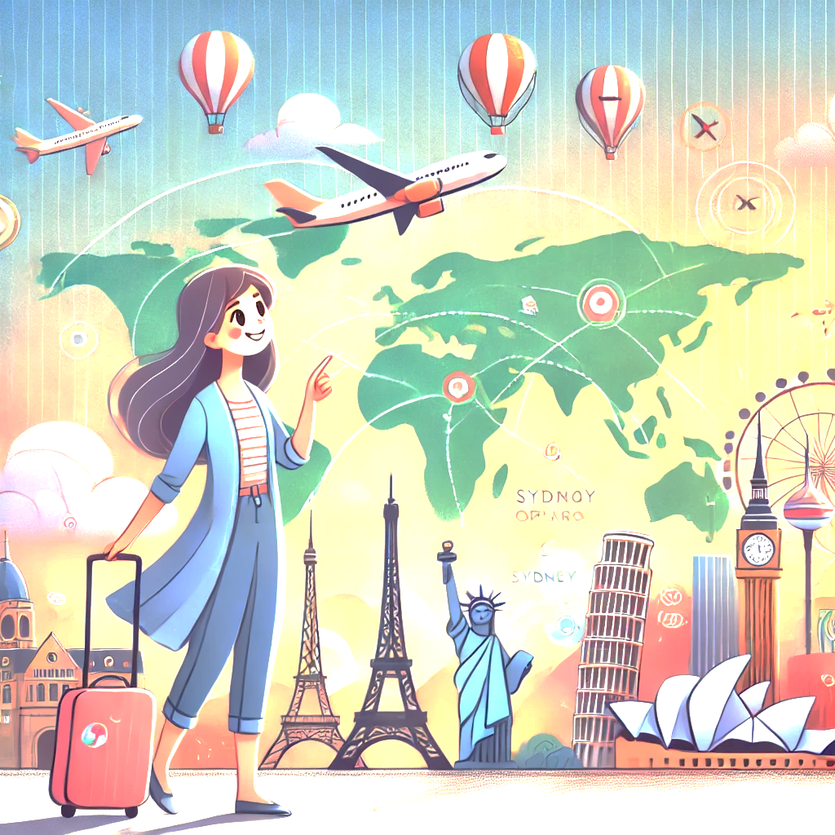
WanderTales: AI-Powered Travel Stories & Recommendations
Experience Your Journey Before It Begins – Smart AI Travel Planning

Slide 2
Introduction
Problem: Travelers often struggle to plan personalized trips and visualize their experiences in advance.
Objective: Our AI-driven app solves this by creating customized travel itineraries, immersive stories, and realistic AI-generated images & videos, helping users explore their journey before it even begins.

Slide 3
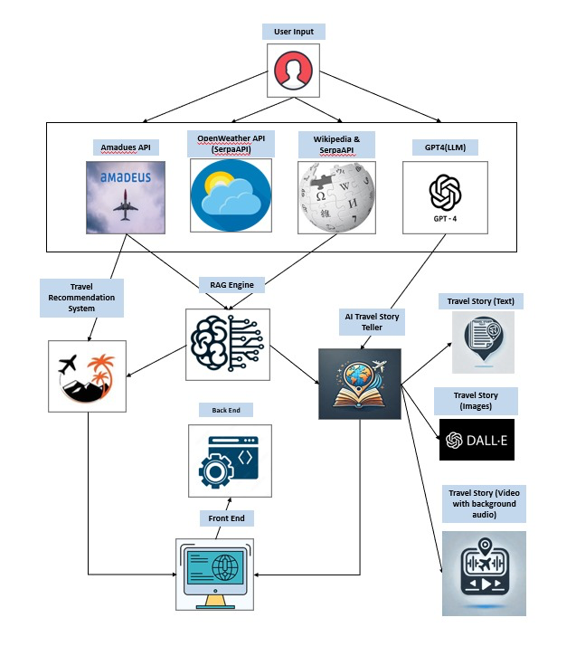
System Architecture

Slide 4
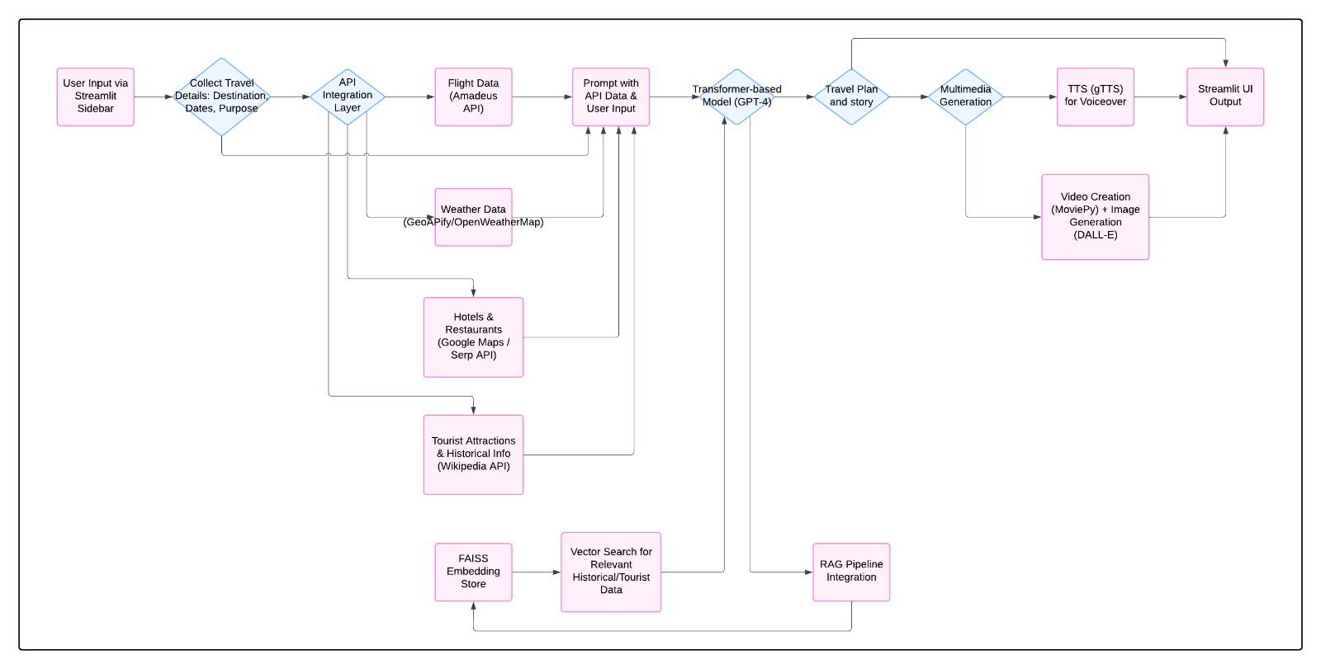
Model Workflow

Slide 5
Application Interface (UI/UX)
Wireframe Overview
Left Sidebar: Users enter origin, destination, travel dates, and purpose for personalization.
Main Display: AI-generated travel plan, story, and realistic images/videos appear dynamically.
Interactive Elements: Smooth transitions, engaging layouts, and clear visual hierarchy enhance usability.
User Flow:
Enter Details → AI Generates Personalized Content → View & Explore Travel Plan with Multimedia

Slide 6
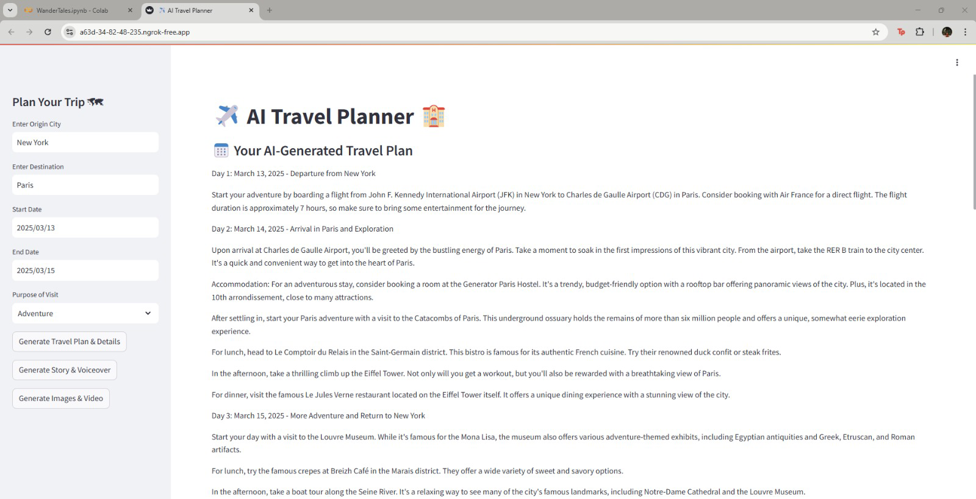

Slide 7
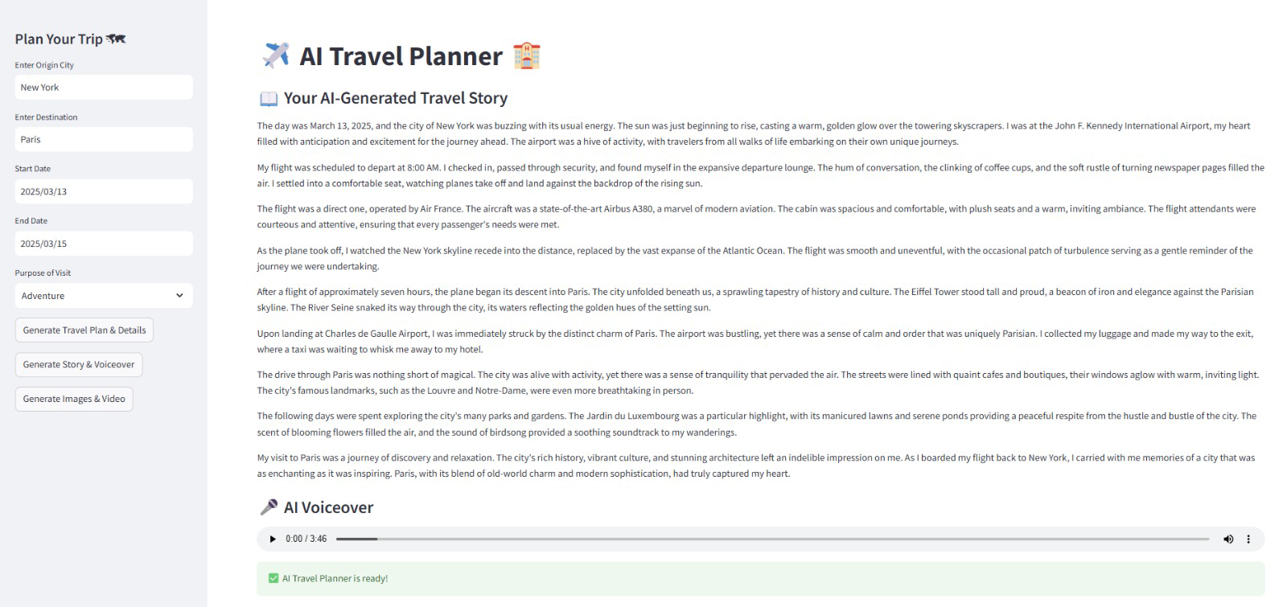

Slide 8
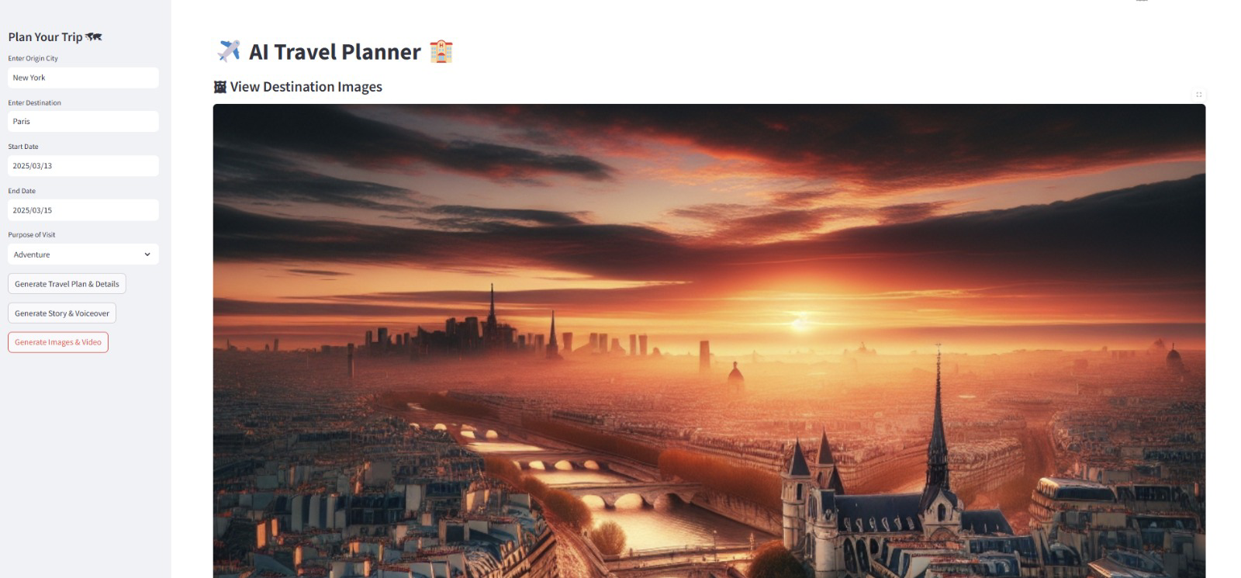

Slide 9
Models and Technologies
GPT-4 – Fine-tuned for personalized, coherent travel plans
DALL·E – Created realistic, prompt-accurate travel images
RAG – Enhanced plans with real-time travel data
gTTS – Converted stories into natural-sounding audio

Slide 10
NeurIps paper implementation
Core Idea: Leverage a pre‐trained diffusion UNet encoder to extract rich semantic features from any image.
Segmentation: Apply a recursive Normalized Cut on those features to partition the image into coherent regions—no labeled data needed.
Refinement: Use a pixel‐affinity module (PAMR) and median filtering to sharpen boundaries and clean up noise.

Slide 11
DiffCut and Normalised cut algorithm application
Set Up & Cloning: Pulled the DiffCut repo into Colab, installed dependencies, and resolved import paths.
Custom Image Upload: Allowed manual upload of any travel photo (e.g. Eiffel Tower + boy).
Feature Extraction & Masking: Ran the LDM extractor, generated raw segmentation masks, then refined them.
Overlay View: Color‐coded mask on top of the original for clear region separation.
Isolation View: Automatically isolated the main subject and blurred the background for a polished look.

Slide 12
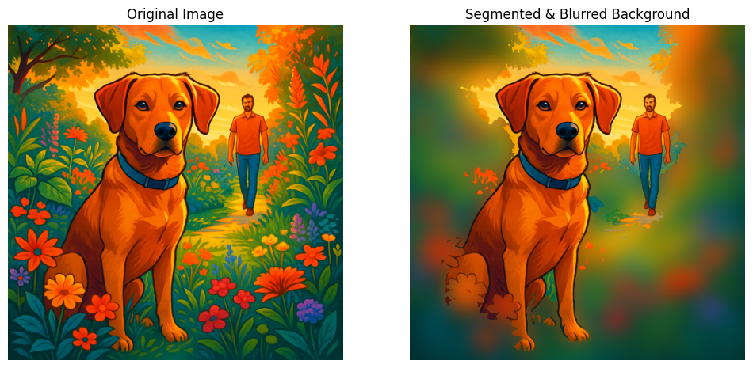
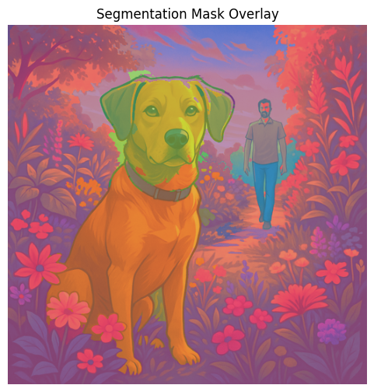
Sample results

Slide 13
Relevance to wandertales
Auto Landmark Highlighting: Zero-shot masks let us spotlight monuments, attractions, or key objects in user photos without manual cropping.
Enhanced Storyboarding: Isolated subjects can be recombined into AI-generated scenes, sketched visuals, or AR overlays—making each itinerary slide more engaging.
Time & Scale: Works “out of the box” on any photo (historic, user-snapped, AI-created), so WanderTales can scale visual storytelling without extra labeling effort.
Next Steps: Integrate mask-based filters, thematic overlays, and interactive annotations to further enrich the travel narratives.

Slide 14
LLM CHECK PAPER IMPLEMENTAION
Calculated Token-level output probabilities to measure how "confident" the model was.
Perplexity:
Measures how likely the model finds the generated response.
Higher perplexity = more surprising = possibly hallucinated.
Steps:
It gets the model's logits (raw scores before softmax) for each token.
Applies softmax to get probabilities for each possible next token.
Picks the probability of the actual token that was chosen/generated.
Calculates negative log probability.
Averages across all tokens → that is the Perplexity.

Slide 15
Logit Entropy:
Computes the entropy of token distributions (uncertainty in prediction).
High entropy = more uncertainty = possibly hallucinated.
Steps:
After getting logits, apply softmax to get probabilities.
For each token prediction, calculate entropy:
Entropy = sum over all tokens of (probability × log(probability))
Higher entropy means the model was less sure what to choose.
Optionally, it can:
Only calculate over the top-k most probable tokens (to remove noise).
Slide a window over tokens (to catch small hallucinated parts).

Slide 16
RELEVANCE TO WANDERTALES
Metric/Model | Gpt-2 | Llama-2-7b-hf | EleutherAI/gpt-neo-1.3B
Perplexity | 38.89 | 9.59 | 24.99
Entropy | 4.01 | 2.1230 | 3.0510
Helps detect hallucinations in AI-generated travel plans using measurable metrics like perplexity and entropy.
Works with GPT-4 through black-box evaluation, since we don’t have access to internal model weights.
Improves quality and trust by flagging uncertain or inaccurate content automatically.

Slide 17
Contributions
Viswanth Tammana: Developed a Travel Recommendation System, Integrated APIs, explored Stable Diffusion for images, experimented with animation, and documented AI/ML architecture. Implemented DiffCut paper.
Dharani Thakkallapally: Optimized AI-driven travel stories, visuals, and videos, enhanced personalization, improved performance with ONNX, and documented progress.
Pavan sundar reddy guthikonda: Developed and deployed the Streamlit frontend, resolved deployment issues, optimized UI performance, and improved app speed with async API calls.
Banu Teja Jampani: Developed a Travel Recommendation System integrating APIs for hotels, restaurants, and seamless itinerary planning based on user preferences

Slide 18
Future Work
Enhancing video generation with dynamic elements
Deployment
Performance metrics

Slide 19
Conclusion
Our AI-powered travel companion transforms trip planning into an immersive adventure, delivering personalized itineraries, stunning visuals, and interactive previews. With real-time insights and AI-driven storytelling, we make every journey exciting before it even begins

Slide 20

Thank you

